Slide 1

Mathematical Modelling and

Slide 2
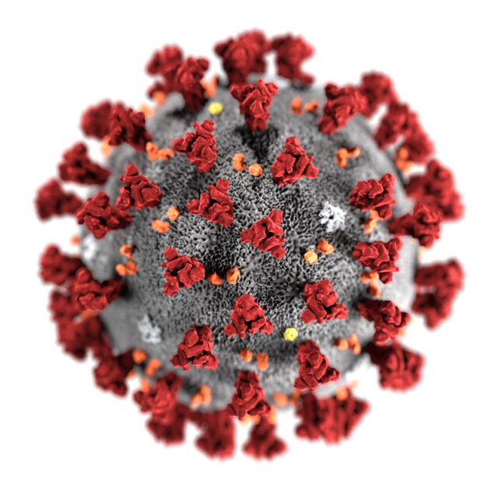
What new words and phrases did we learn in 2020?
Social distancing
R number
Transmission rate
Recovery rate
Herd immunity
Flattening the curve
Exponential growth
Lockdown
Second wave
Vaccine
Nightingale
PPE
Delay the peak
Can you explain any?

Slide 3
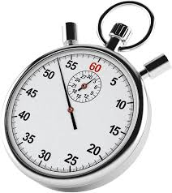


When did the covid-19 timeline start?
The World Health Organisation identifies 31st Dec 2019 as the first action taken over rumours of an outbreak of viral pneumonia.
What happens when an outbreak is noticed?
When data emerges that could signify an epidemic, researchers across the world will begin to monitor the situation.
How is it monitored?
Researchers will plot early data and look at it’s behaviour.
Mathematical models are used to predict what may happen.
Adjustments can be made as new data comes to light.

Slide 4
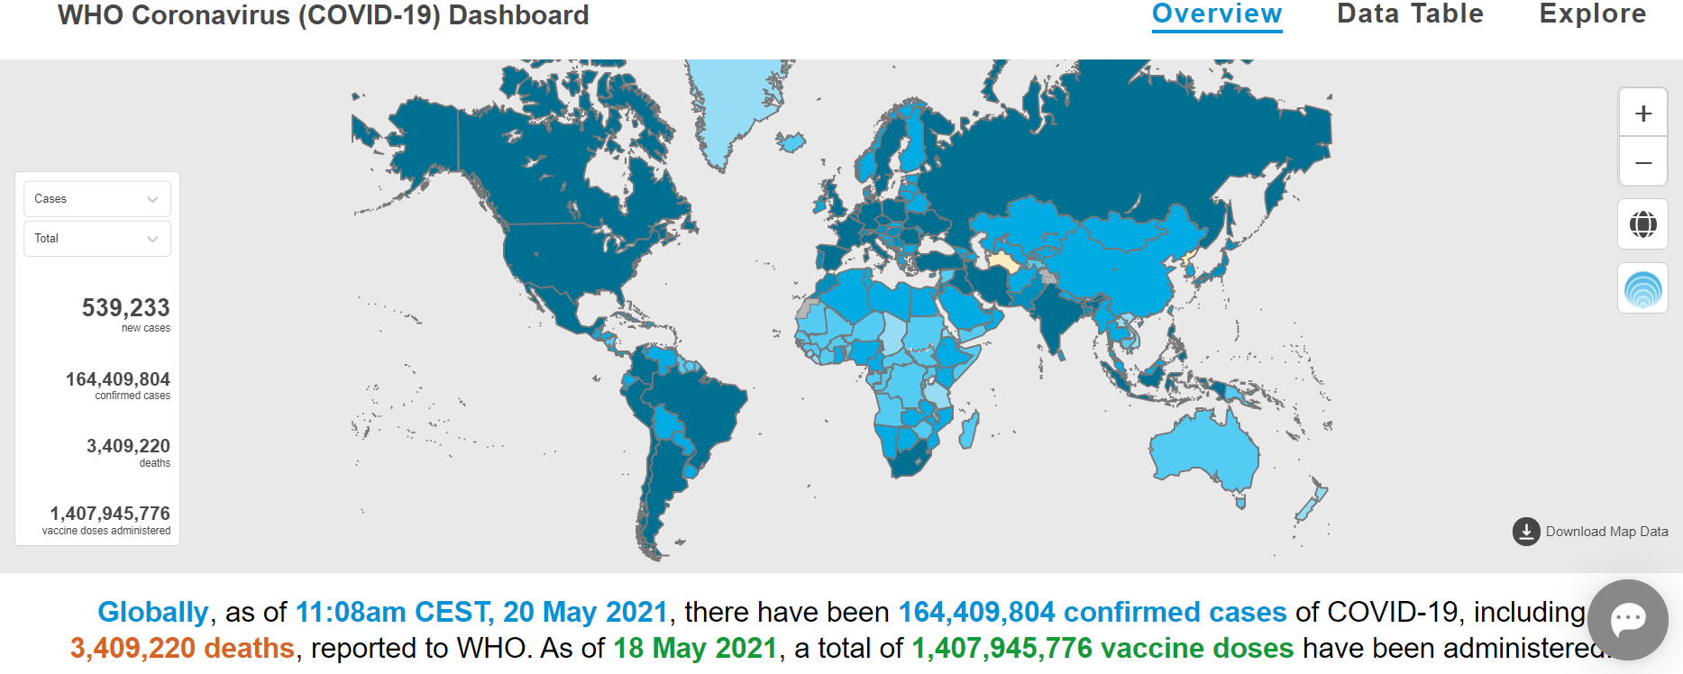
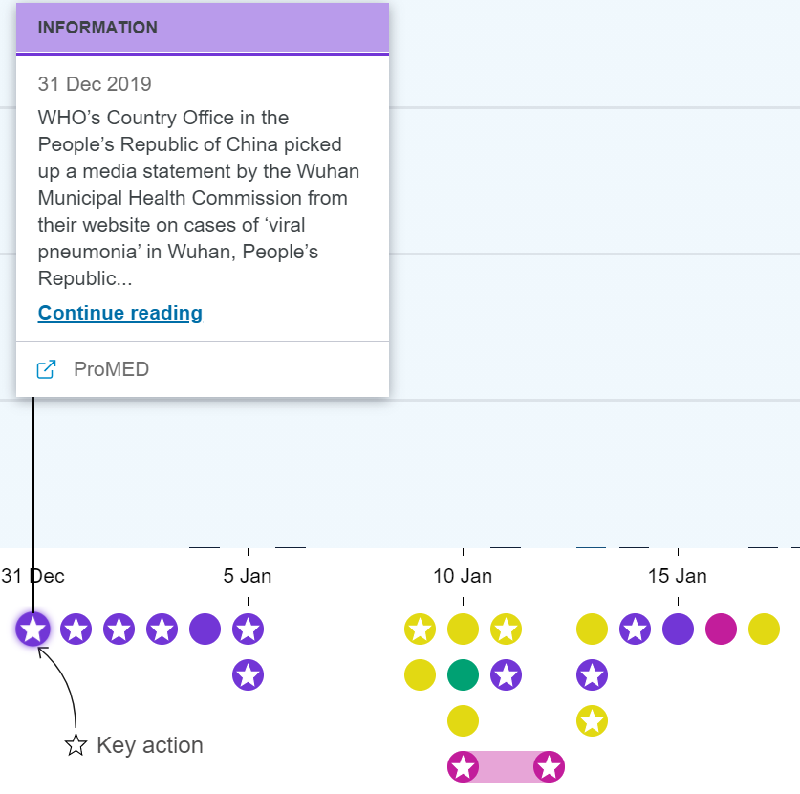


Follow the links for data and timelines
Interactive covid-19 response timeline
Covid-19 dashboard and graphs
An organisation that monitors for outbreaks

Slide 5
Modelling assumptions
Who can catch the disease?
Ignore natural immunity.
Model: The whole population is susceptible to the new disease.
A mathematical model allows us to investigate manageable aspects of a real context.
Initially we may choose to ignore quite a lot.
Once we begin to understand the mathematics of the context, we can try to refine the model and apply more sophisticated mathematics.
Here are just a few …
When does a person become infectious?
Ignore the incubation period.
Model: A susceptible person becomes infectious as soon as they are in contact with an infective
Does the population vary?
Ignore birth-rates.
Model: The population will have a fixed, finite value.

Slide 6

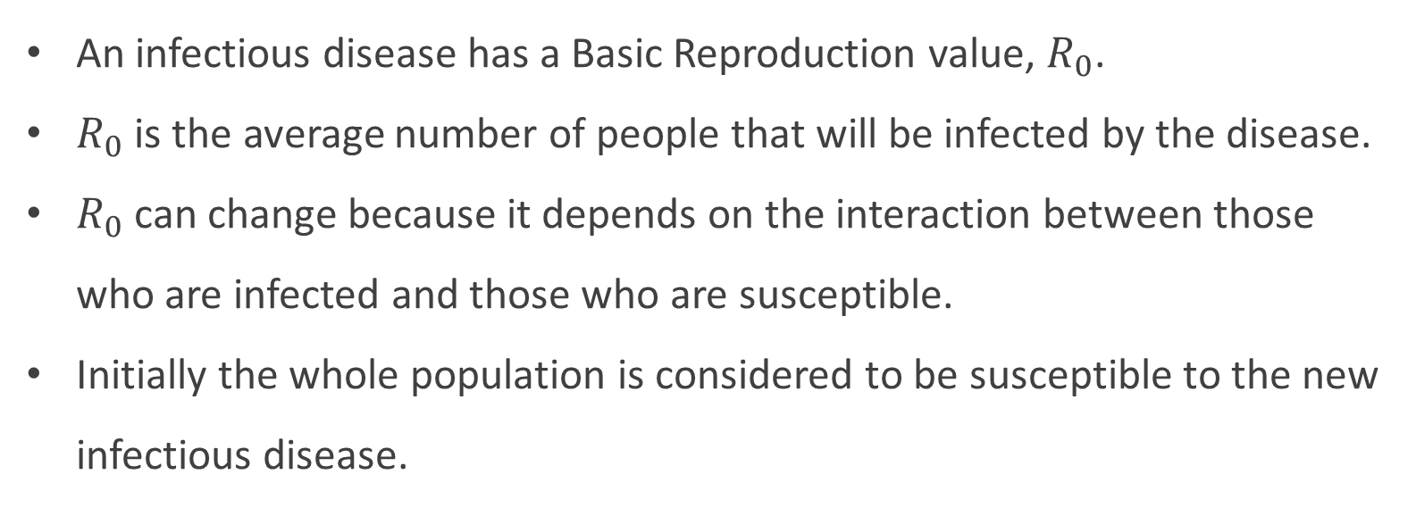
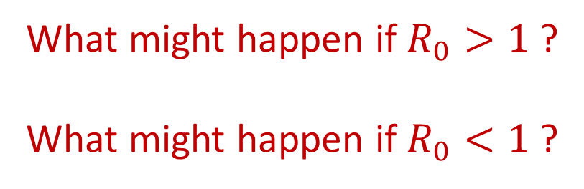
R number
An infectious disease has a Basic Reproduction value, $R_{0}$.
$R_{0}$ is the average number of people that will be infected by the disease.
$R_{0}$ can change because it depends on the interaction between those who are infected and those who are susceptible.
Initially the whole population is considered to be susceptible to the new infectious disease.
What might happen if $R_{0}>1$ ?
What might happen if $R_{0}<1$ ?

Slide 7

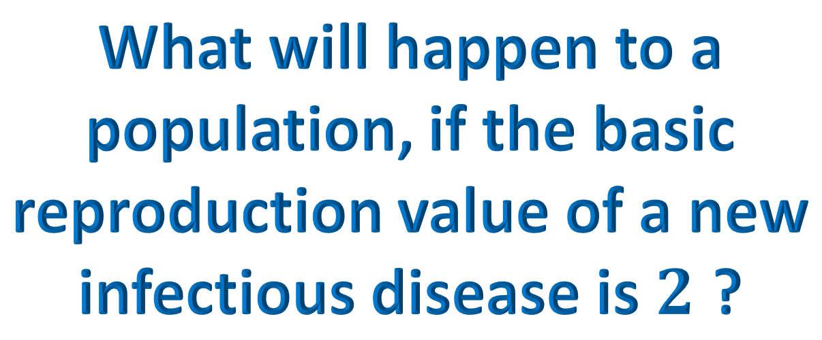
What will happen to a population, if the basic reproduction value of a new infectious disease is $2$ ?

Slide 8



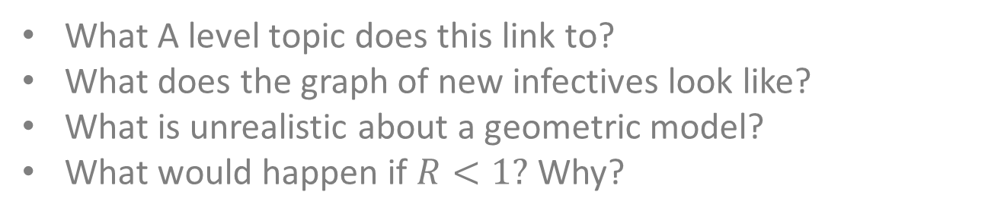
A Geometric Model for infectious disease spread
$$R_{0}=2$$
What A level topic does this link to?
What does the graph of new infectives look like?
What is unrealistic about a geometric model?
What would happen if $R<1?$ Why?

Slide 9
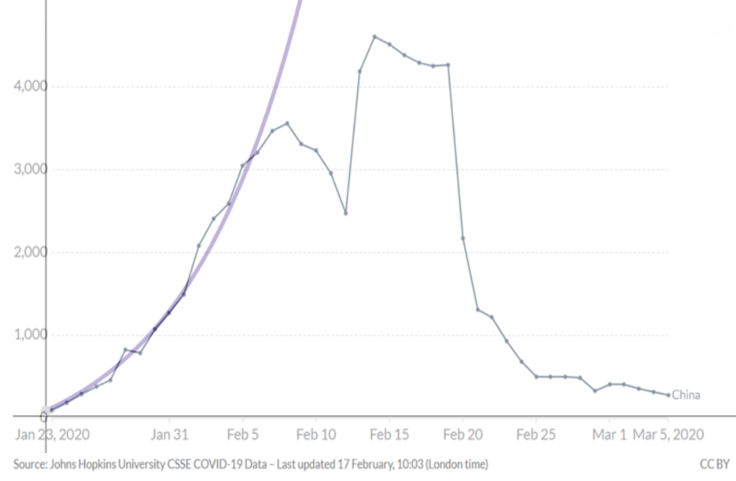
An exponential curve is overlaid on covid-19 data from China
Initially the data follows the exponential curve.
Will an exponential curve ever flatten?
Can we prove it?
A Geometric model may be useful in the early stages but not for long periods of time.

Slide 10
Modelling Limitations
This model shows new infectives increasing forever.
However, the population is assumed to be fixed and finite.
What are the limitations of a geometric model?
How could it be refined?
The curve is not consistent with an outbreak curve.
There is not a peak to the outbreak (which is an important value).
An improved model requires a curve that increases rapidly, reaches a peak and then falls away again.
The recovery rate has been ignored.
It is assumed that once infected, an individual remains infected.

Slide 11



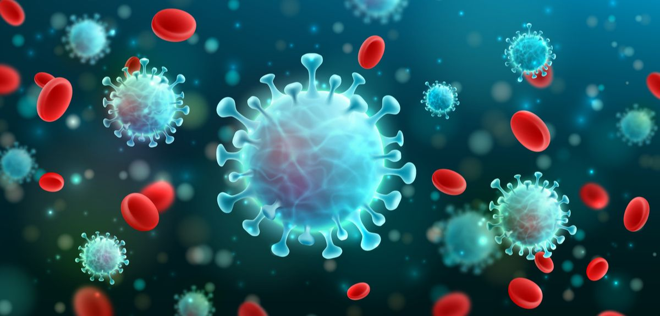
Independent tasks

Slide 12
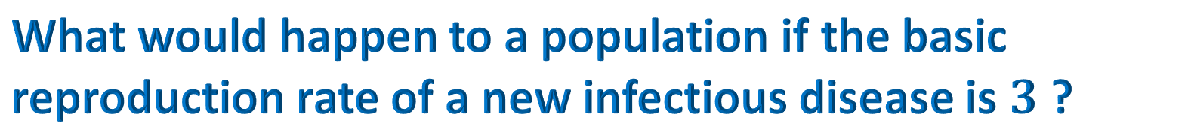

What would happen to a population if the basic reproduction rate of a new infectious disease is $3$ ?
State the first term and common ratio for the geometric progression?
How many new cases will there be after $7$ progressions?
How many new cases will there be after $n$ progressions?
Sketch a graph for the number of new cases against time.
Use differentiation to show that the number of new cases will continue to rise.
Explain a limitation of this model.

Slide 13
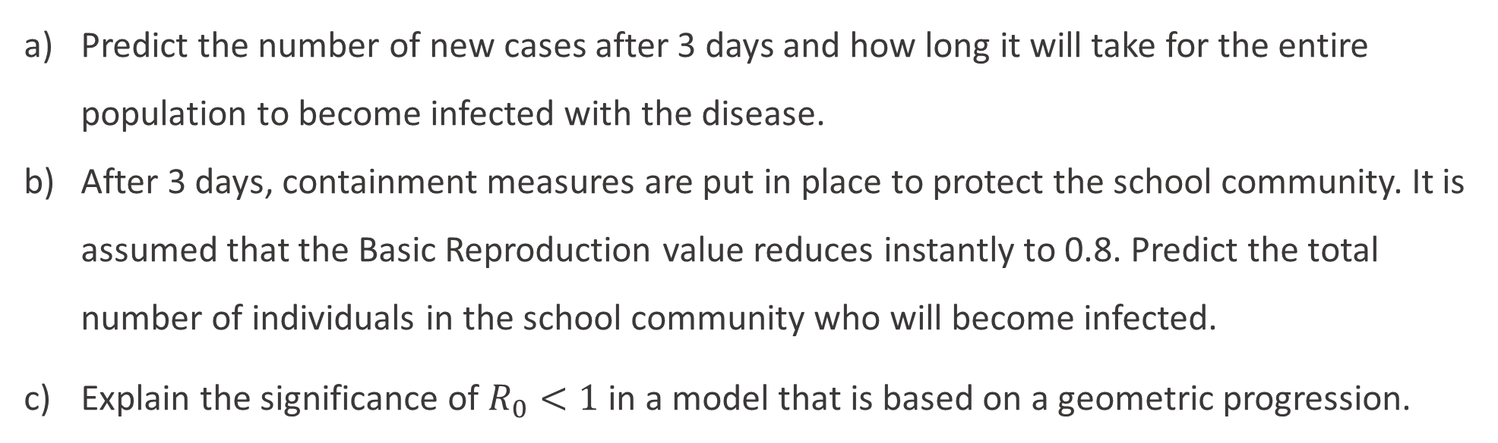
Consider the spread of a new infectious disease in a remote community environment.
A boarding school has 500 students and 60 staff who all live on the school site.
At the beginning of term, one student arrives showing symptoms of an infectious disease.
The infectious disease has a Basic Reproduction value of 2.5.
No measures are taken to isolate the individual.
Predict the number of new cases after 3 days and how long it will take for the entire population to become infected with the disease.
After 3 days, containment measures are put in place to protect the school community. It is assumed that the Basic Reproduction value reduces instantly to 0.8. Predict the total number of individuals in the school community who will become infected.
Explain the significance of $R_{0}<1$ in a model that is based on a geometric progression.

Slide 14
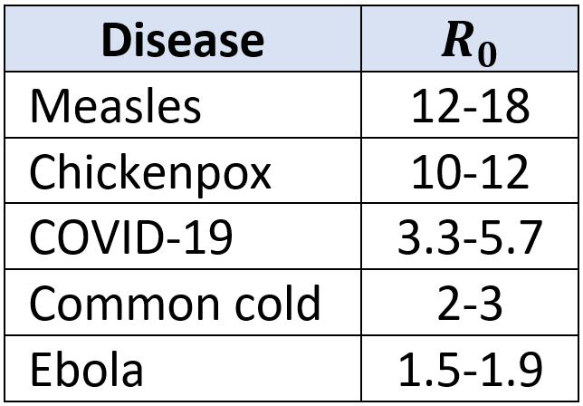
Discuss: R numbers
The table gives an estimated range of values for the Basic Reproduction number of different diseases.
Would an outbreak of Chickenpox spread more rapidly through a local community than COVID-19?

Slide 15

Discuss: the characteristic curve
The graph shows the number of cases of COVID-19 recorded by China and has been overlaid with an exponential curve. In the early stages of the outbreak, the exponential curve follows the data closely
Why does the data stop following an exponential curve? What factors should be considered in an improved model?

Slide 16
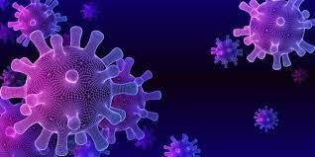
Ideas to explore further

Slide 17

Follow the link for related articles

